Slide 1
Evaluation and reflections
By RAGCyT
PARTNER LOGO AREA
This project has received funding from the European Union’s Horizon 2020 research and innovation programme under grant agreement No. 872427.
Copyright © GENDER STI Consortium 2020 – 2023

Slide 2
Key points about networking
* Social, cultural differences in the various geographies involved
*Epistemological differences
* Different conceptions of gender
* Different contexts of struggle for equity

Slide 3
Work Packages
WP 1 Mapping gender equality in STI bilateral and multilateral agreements
WP 2 Comparative analysis and benchmarking on gender equality in STI dialogues
WP3 GENDER STI Co-Design Labs
WP4 Recommendations for implementing gender equality in STI dialogues
WP5 Communication, Dissemination and Exploitation

Slide 4
WP 1 Mapping gender equality in STI bilateral and multilateral agreements
Limitations with the NGOs.
In Argentina we observe zero activity with NGOs
We carried out a survey on bilateral and multilateral
cooperation agreements on gender equality
in Universities, Ministries, Programs and
private Organizations
We found 74 agreement between UE – Argentina
26 Cooperation Agreement
32 Formal Bilateral Agreement
1 Formal Multilateral Agreement
5 MOU
10 STI Implementation Activities

Slide 5
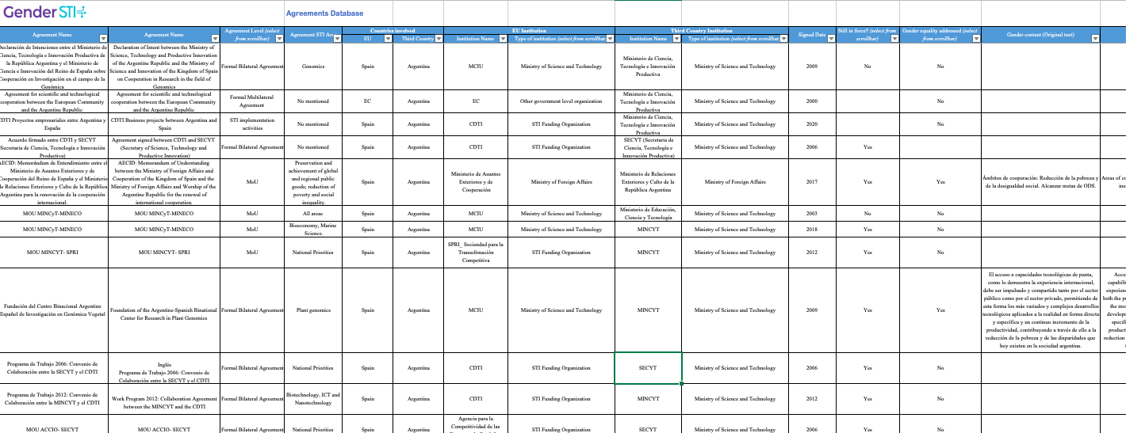
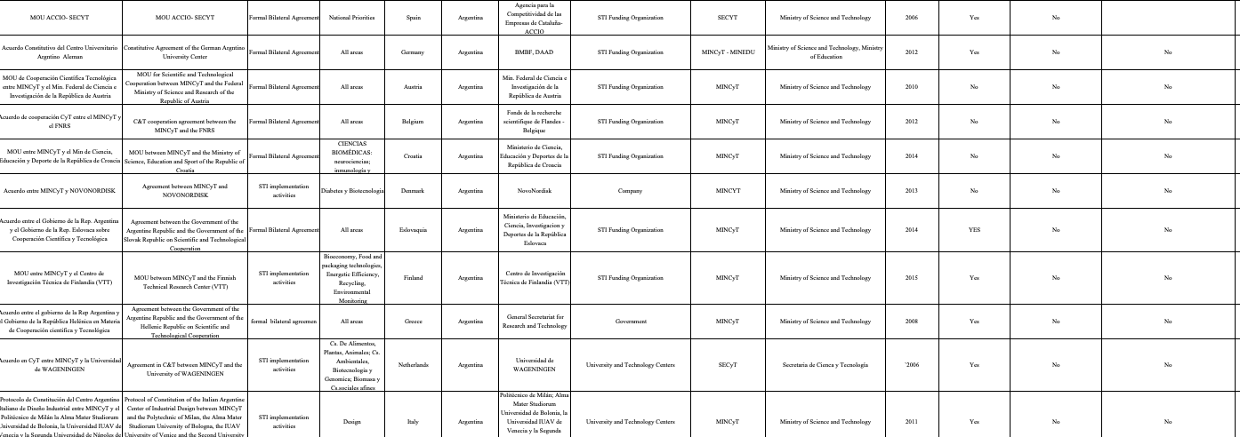
In the agreements found, the mention of gender did not include greater possibility or equal participation
The mention of a gender perspective begins in the closest years

Slide 6
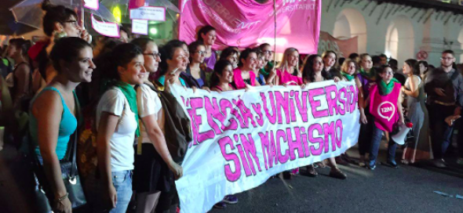
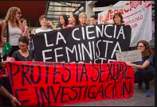
Search partners:
A sample of key stakeholders was selected, including representatives from ministries, funding agencies and universities, among others.
“that in the agreements it says gender does not imply that they include us or that they contemplate the obstacles for being a woman”
University Teacher (52 yeas old)
“Only when the struggle of women is on the political agenda, does the gender perspective begin to be included in bilateral agreements.” Researcher of the Technological Scientific System. (40 yeas old)
“In all my years as an official,
I have never seen gender equality included.” Undersecretary of education (64 yeas old)

Slide 7
WP 2 Comparative analysis and benchmarking on gender equality in STI dialogues
We review the surveys, and we focus on interviews with referents:
Addressed to Ministers or Secretaries of areas of International Cooperation
National Ministry of Sciences and Technology,
CONICET,
National Women Ministry,
National Production Ministry
National Education Ministry,
National Universities (most relevant of our country)
We make some graphs based on the most representative scientific sectors of inequity that in turn carry out most of the bilateral agreements

Slide 8
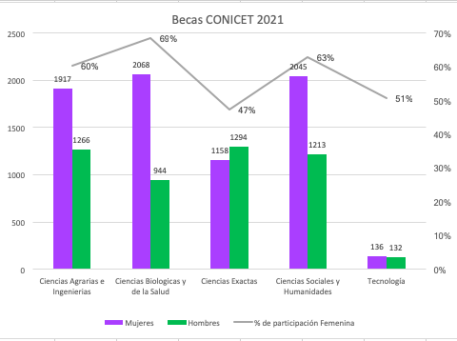
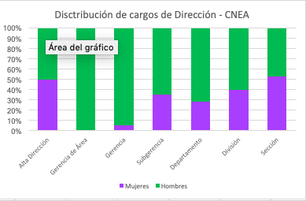
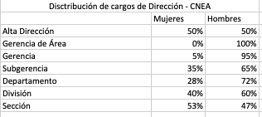
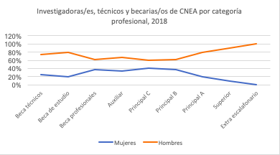
The numbers in Argentina are very problematic. These limits are reflected in the absence of a gender perspective in bilateral agreements.

Slide 9
All the interviewees showed in common that gender aspects had not been contemplated in the agreements (in any type of agreement.
All pointed out that it was not established in any of the forms
None of the surveys mentioned that there was a demand for gender equality. And when faced with the question, the unanimous answer was that there was a bias in the relationship between men and women in favour of men.

Slide 10
WP3 GENDER STI Co-Design Labs
We achieved presence and active participation in the Labs
We were able to understand from what place to contribute in the periods between each of the meetings.
We consider that the plurality of perspectives and experiences gave the project greater realism
The language limited us at times, so the help of colleagues was invaluable

Slide 11
Most important conclusion of the Labs
We believe that an interesting initiative would be to carry out small meetings on the internet thataccount for the data that is being produced. As a way to make visible the different experiencesof women in science and the situations they must go through in an unequal system. Likewise,we believe it is important to convene meetings with the main representatives of these issues inthe countries involved and to be able to establish a kind of communiqué denouncing the lack ofcriteria revealed with regard to bilateral agreements and gender.
We highlight some of our proposal:
Planned to revise the general clause on gender equity and to include a more specific one in future international cooperation agreements and project proposals MINCYT might be involved.
Establish inclusive regional agendas that respond to the social and economic interests of women. Taking into account the differences by economic, social, cultural sectors, etc.
Analyze that the gender perspective is included in the Project
Reducing horizontal segregation explained by gender stereotypes and sexual division of labour.
Reducing career gaps between men and women in the scientific system.

Slide 12
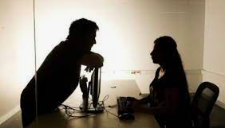
WP4 Recommendations for implementing gender equality in STI dialogues
From the Labs we have been able to exchangewith women and men from different countries, as well as think of long- and medium-termproposals that allow a more participatory construction. What we found most interesting aboutthis was the possibility of seeing the problems in a localized way. Problematizing the notions ofgender, the privileges of belonging to this or that country, and the interdisciplinary view builtfrom the plurality of experiences.
The points thatwe take as the most promising are those that encourage the construction of environments free ofviolence, that is, the possibility of making scientific and technological institutions,environments conducive to development with equality and free from violence. As well as theincorporation of the gender perspective in the processes of research, development andinnovation. At the same time that we have discussed the importance of promoting equality forwomen and the LGTBI+ population in access to hierarchical and/or decision-making positions.

Slide 13
For the WP 4 it was useful to go back to the interviews, more specifically to the long answers. In order to analyze the real weight of the presence of the gender perspective in bilateral agreements:
Especially this question, to think about how to implement changes in bilateral agreements: what could be clearly stated in international cooperation agreements to foster women's participation in STI actions?

Slide 14
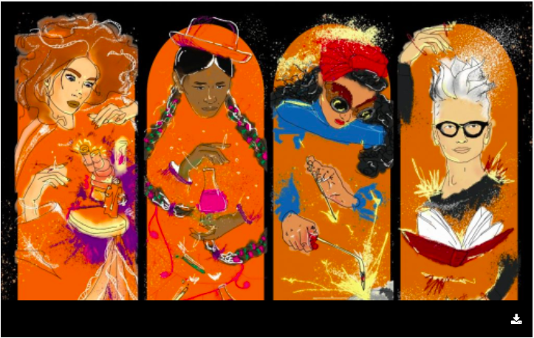
WP5 Communication, Dissemination and Exploitation
Coordination and participation in the Cerebro y Mujer Cycle. with the participation of Yolanda Ursa showing the first results of the network
Presentation of the paper “Gender equity in the International Cooperation in Science, Technology and Innovation”. In Congress Iberoamericano of Science, Technology and Gender. Together with members of the Network

Slide 15
ideas for the future
ideas for the future by RAGCyT

Slide 16
Thank you.
Name
E-mail
www.gender-sti.org

